Slide 1
Summary of findings , conclusions and recommendations
Big Mountain (one of the largest ski resort in Montana state of US) wants to maximize its returns either by cutting cost or adding more facilities for the visitors. Big mountain wants to come up with a pricing model to get a strong sense of what all facilities matter most to the visitors and its relative position in the market depending on those facilities boasted by the resort and for future facility investment plan.
Below are the facilities which matter most to the visitors according to the ticket pricing model
vertical_drop, Snow Making_ac, total_chairs, fastQuads, Runs, LongestRun_mi, trams, SkiableTerrain_ac

Slide 2
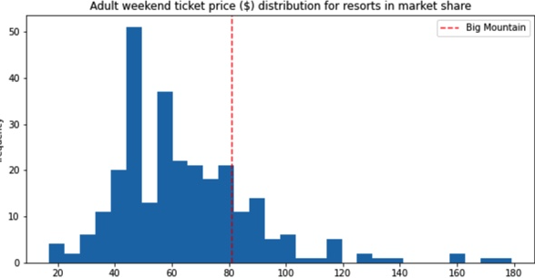
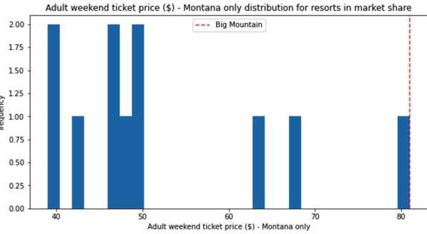
Summary of findings , conclusions and recommendations
Big Mountain Resort modelled price is $95.87. Even with the expected mean absolute error of $10.39, this suggests there is room for an increase with actual price is $81.00.

Slide 3
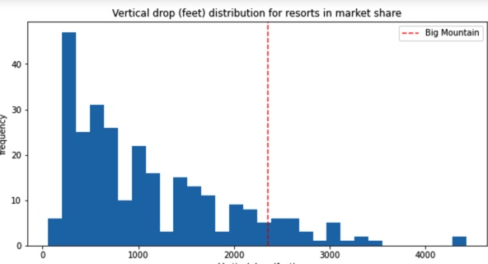
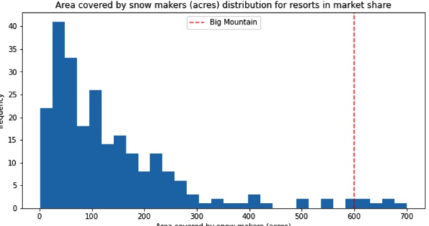
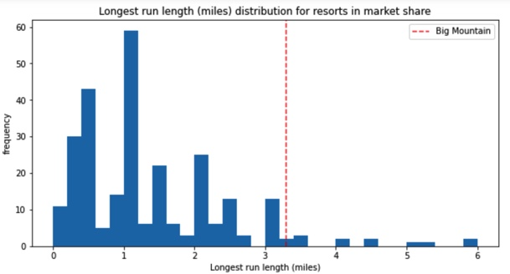
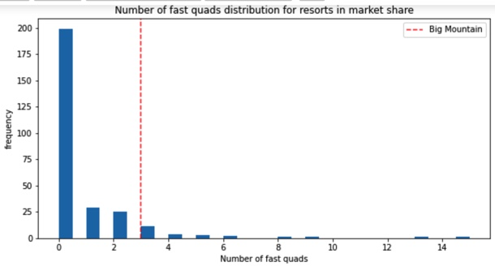
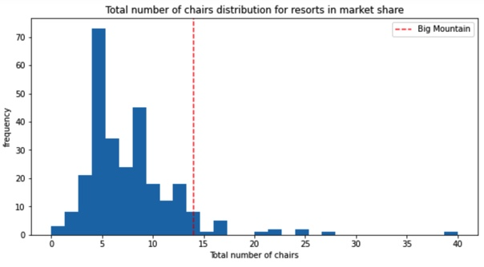
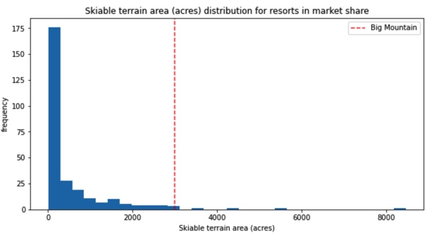
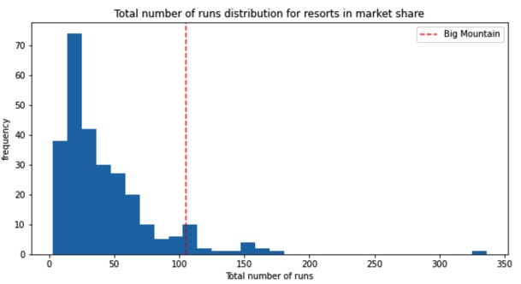
According to the model findings Big Mountain is amongst the resorts with the largest amount of skiable terrain, has one of the largest runs, 3 fast quads , highest number of total chairs which puts it high up that league table Big Mountain is very high up the league table of snow making area and compares well for the number of runs.

Slide 4
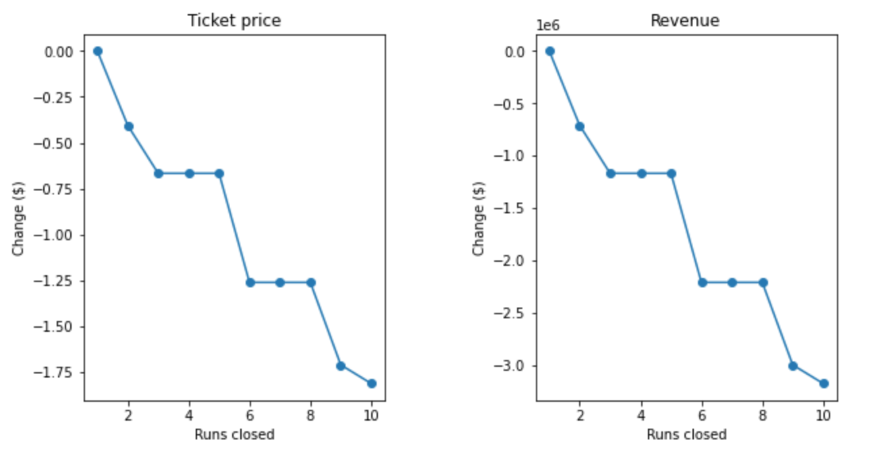
Recommendation as per the pricing model
After reviewing some of the potential scenarios for either cutting costs or increasing revenue (from ticket prices), it turns out that business can decide to close down 1 run , increase the vertical drop by 150 and adding additional chair lift which support the ticket price by $1.99 and revenue by $3474638.

